Slide 1
Walter Pham Portfolio Slides
Junior Web Dev

Slide 2
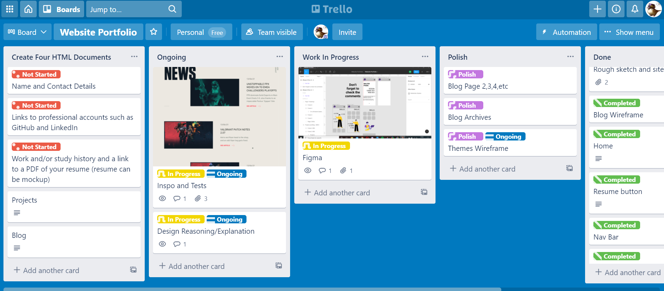
A LIST OF COMPONENTS
HTML | CSS | SASS languages | 1 line of Javascript
VSCode and Git Bash
Fontawesome icons | Google Font
GIT for Version Control
Trello for Project management
Figma for wireframes
Navbar
Notes:
I just knew I needed JavaScript to do cool stuff, but was limited because I haven’t learnt it yet.

Slide 3
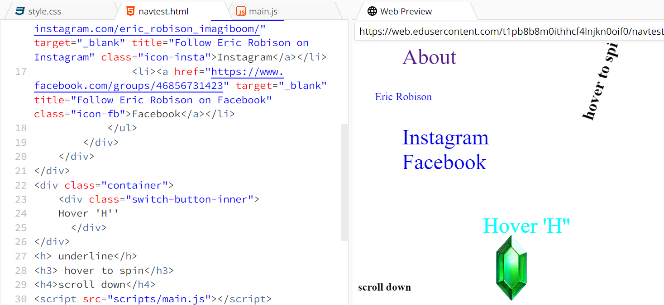
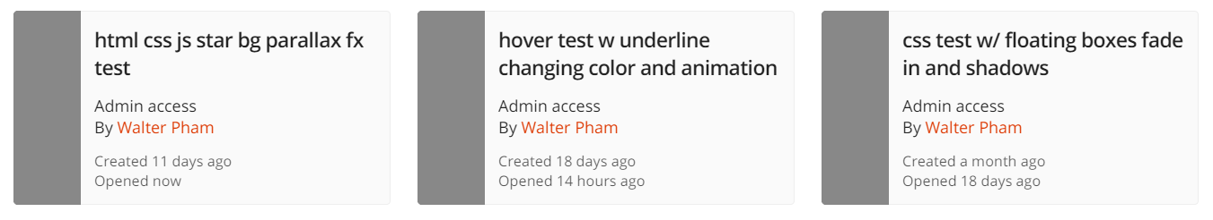
IN THE BEGINNING...
Before the brief
Lot of BIG ideas with no idea how (sort of)
Lot of testing while learning | Ed/w3schools
Inspecting interesting websites

Slide 4
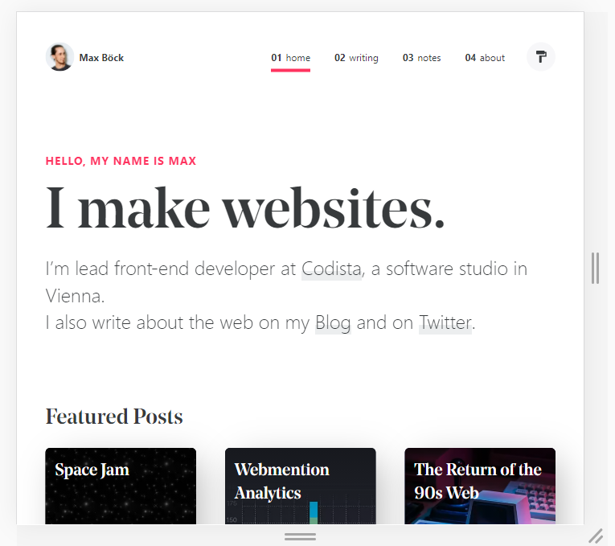
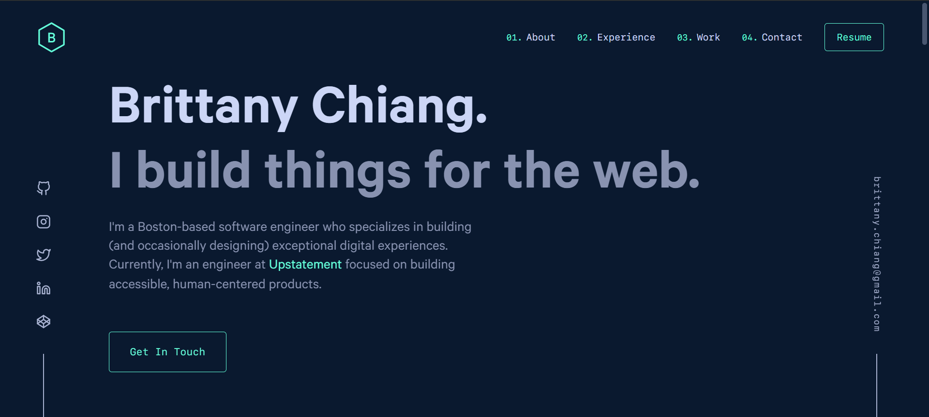
THE BRIEF.
Build around the necessities for scope
Looked and found inspo
Awwwards.com
Notes:
I just knew I needed JavaScript to do cool stuff, but was limited because I haven’t learnt it yet.

Slide 5
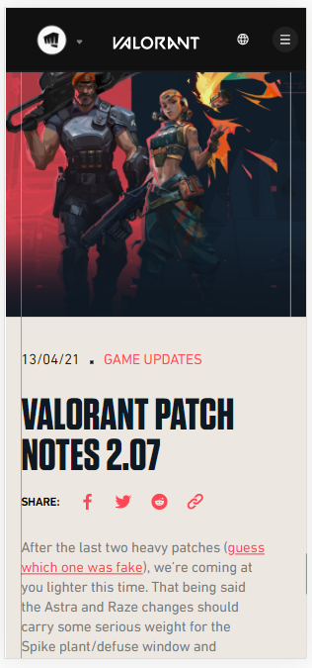
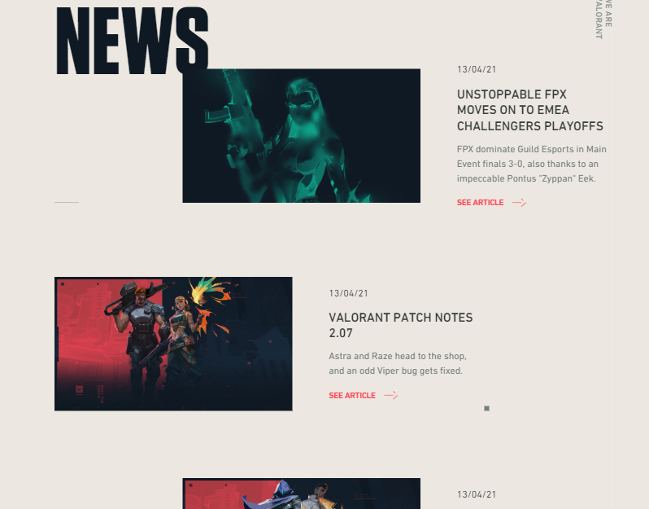
DIRECTION.
Simple//Bold//Clear designs
Felt Achievable
Few colours
Notes:
From the inspo I kinda knew which direction to go

Slide 6

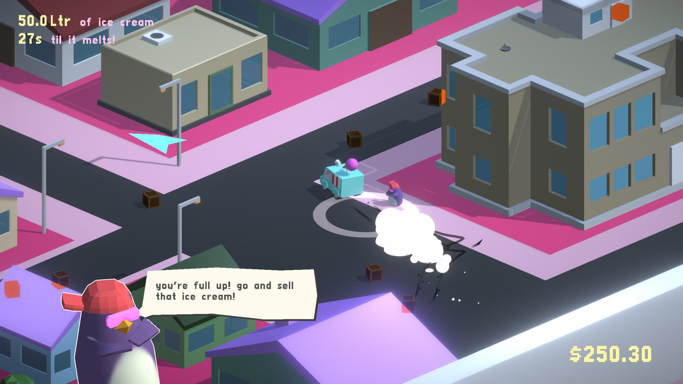

ARTIST? GAMEDEV?
Assessment asks for Dev or IT Professional
Blend skills and more personal
Include artwork and Game Dev
Notes:
From the inspo I kinda knew which direction to go

Slide 7
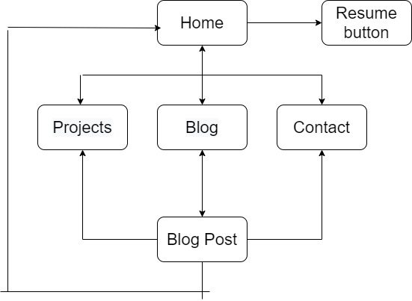
SITEMAP
Home - Short Intro | Interests/Skills
Projects - Variety/Collaboration/Create
Blog | Blog Article
Contact Form
Resume Button opens into PDF
Navbar/Hamburger 🍔
Notes:
From the inspo I kinda knew which direction to go

Slide 8

WIREFRAME VIDEO
Helped a lot to get it down
Less Ambiguity
Know what I’m working on next
Figma was really good
Super easy mobile to desktop

Slide 9
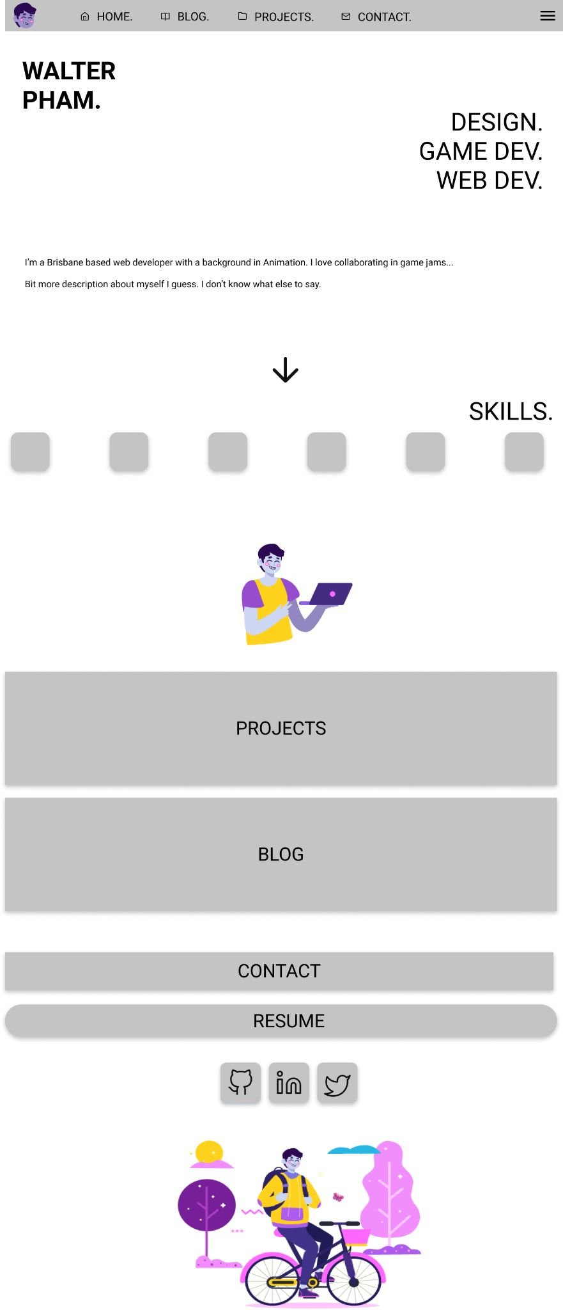
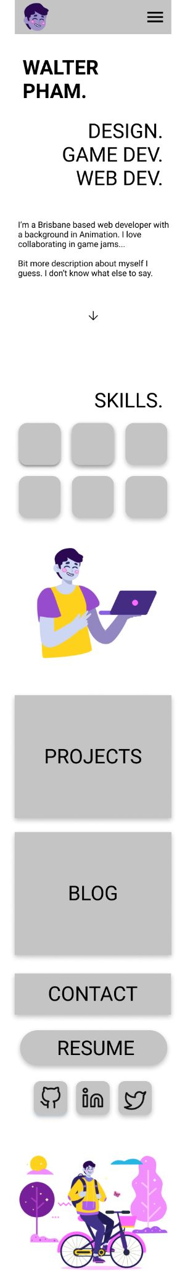
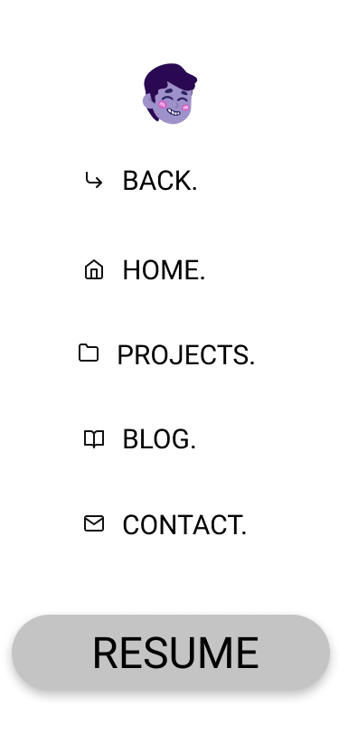

HOME
& NAV BARS
& SOCIAL MEDIA
WIREFRAME

Slide 10
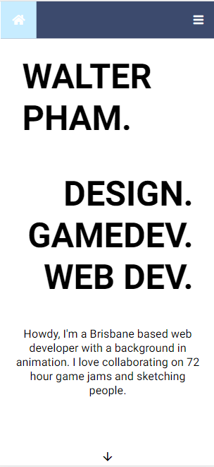
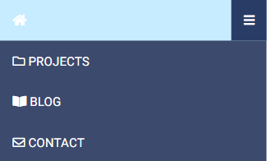
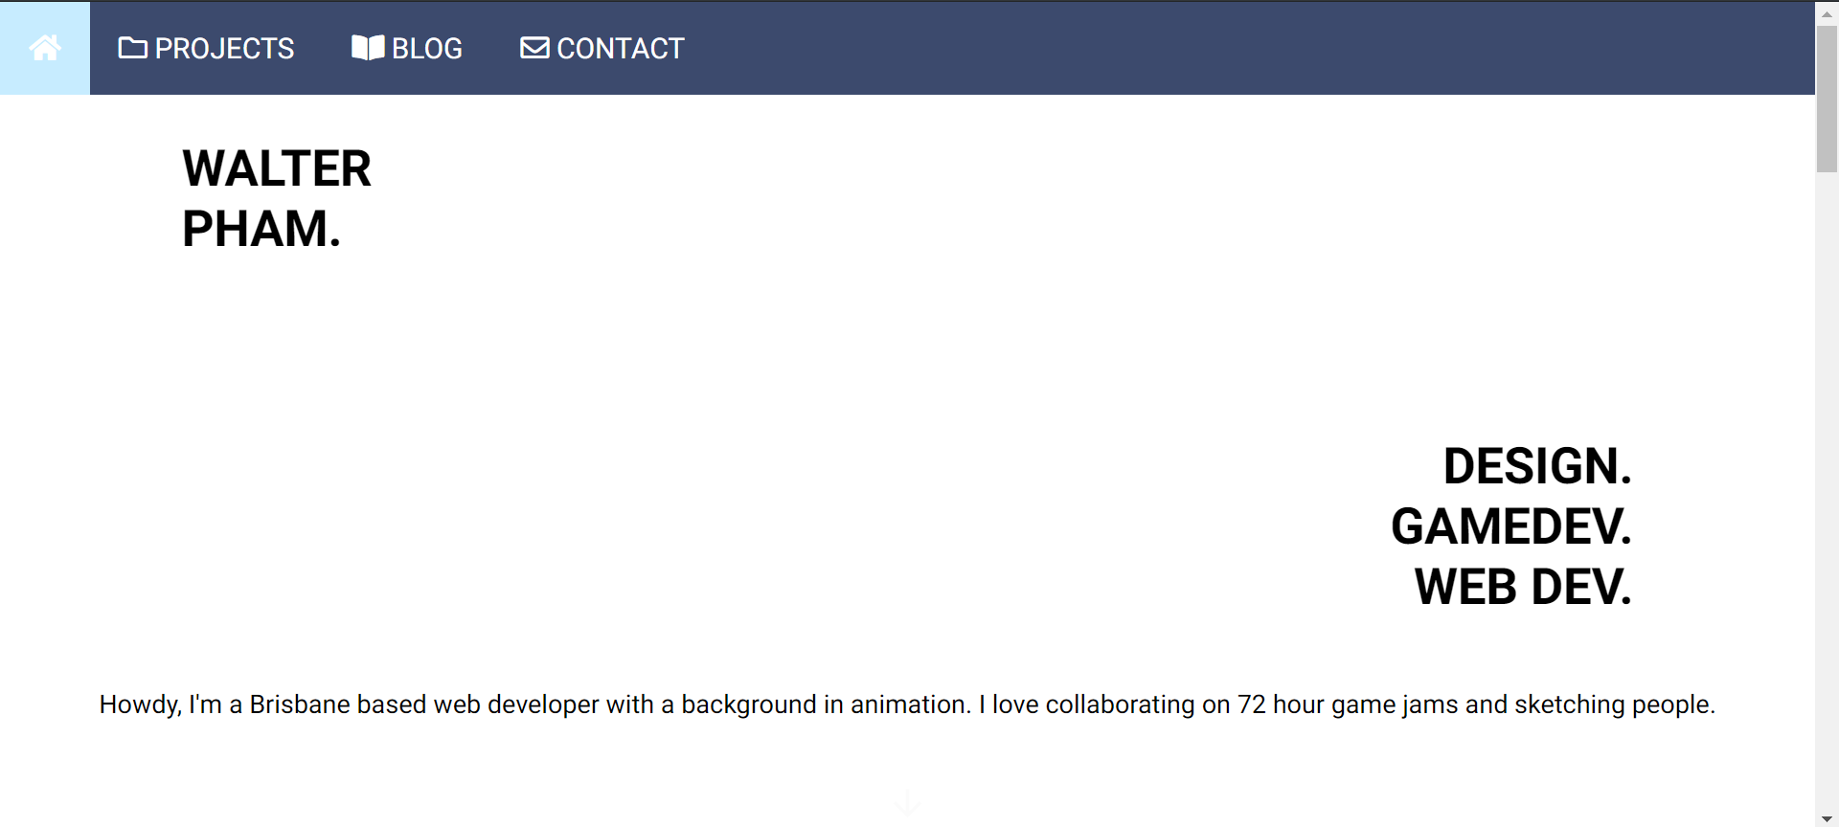
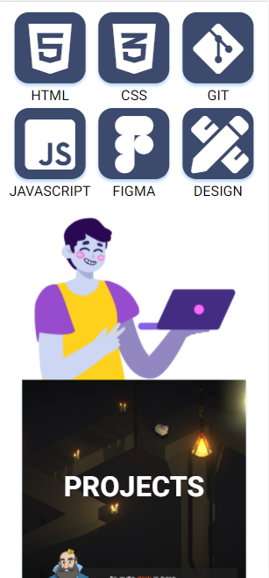
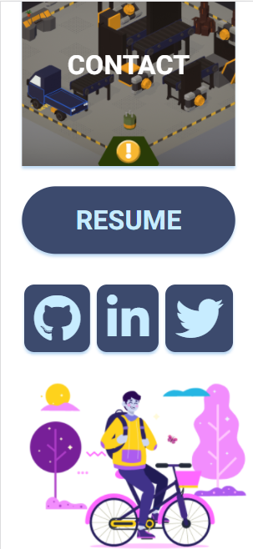
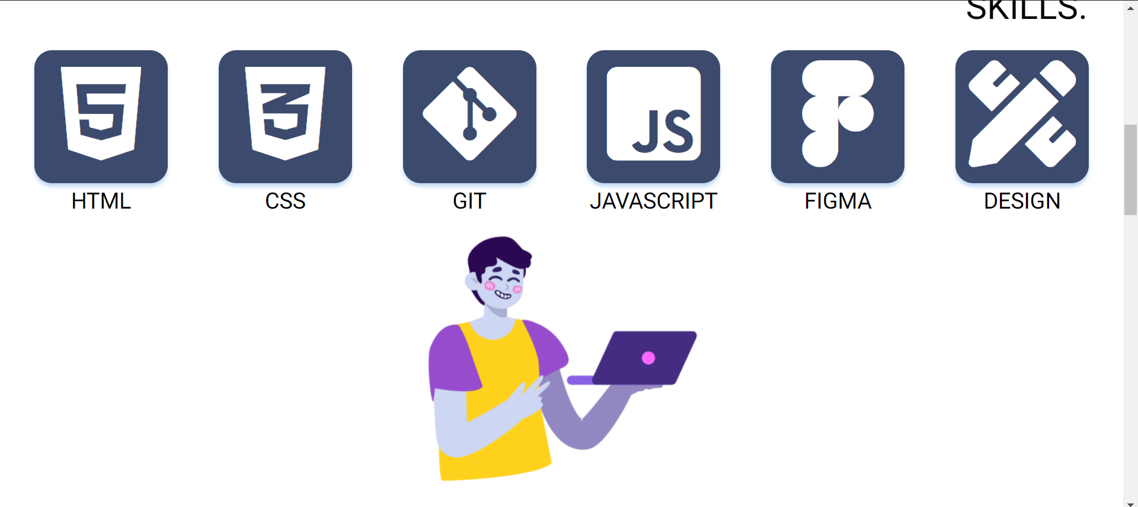
HOME &
NAV BARS WEB

Slide 11
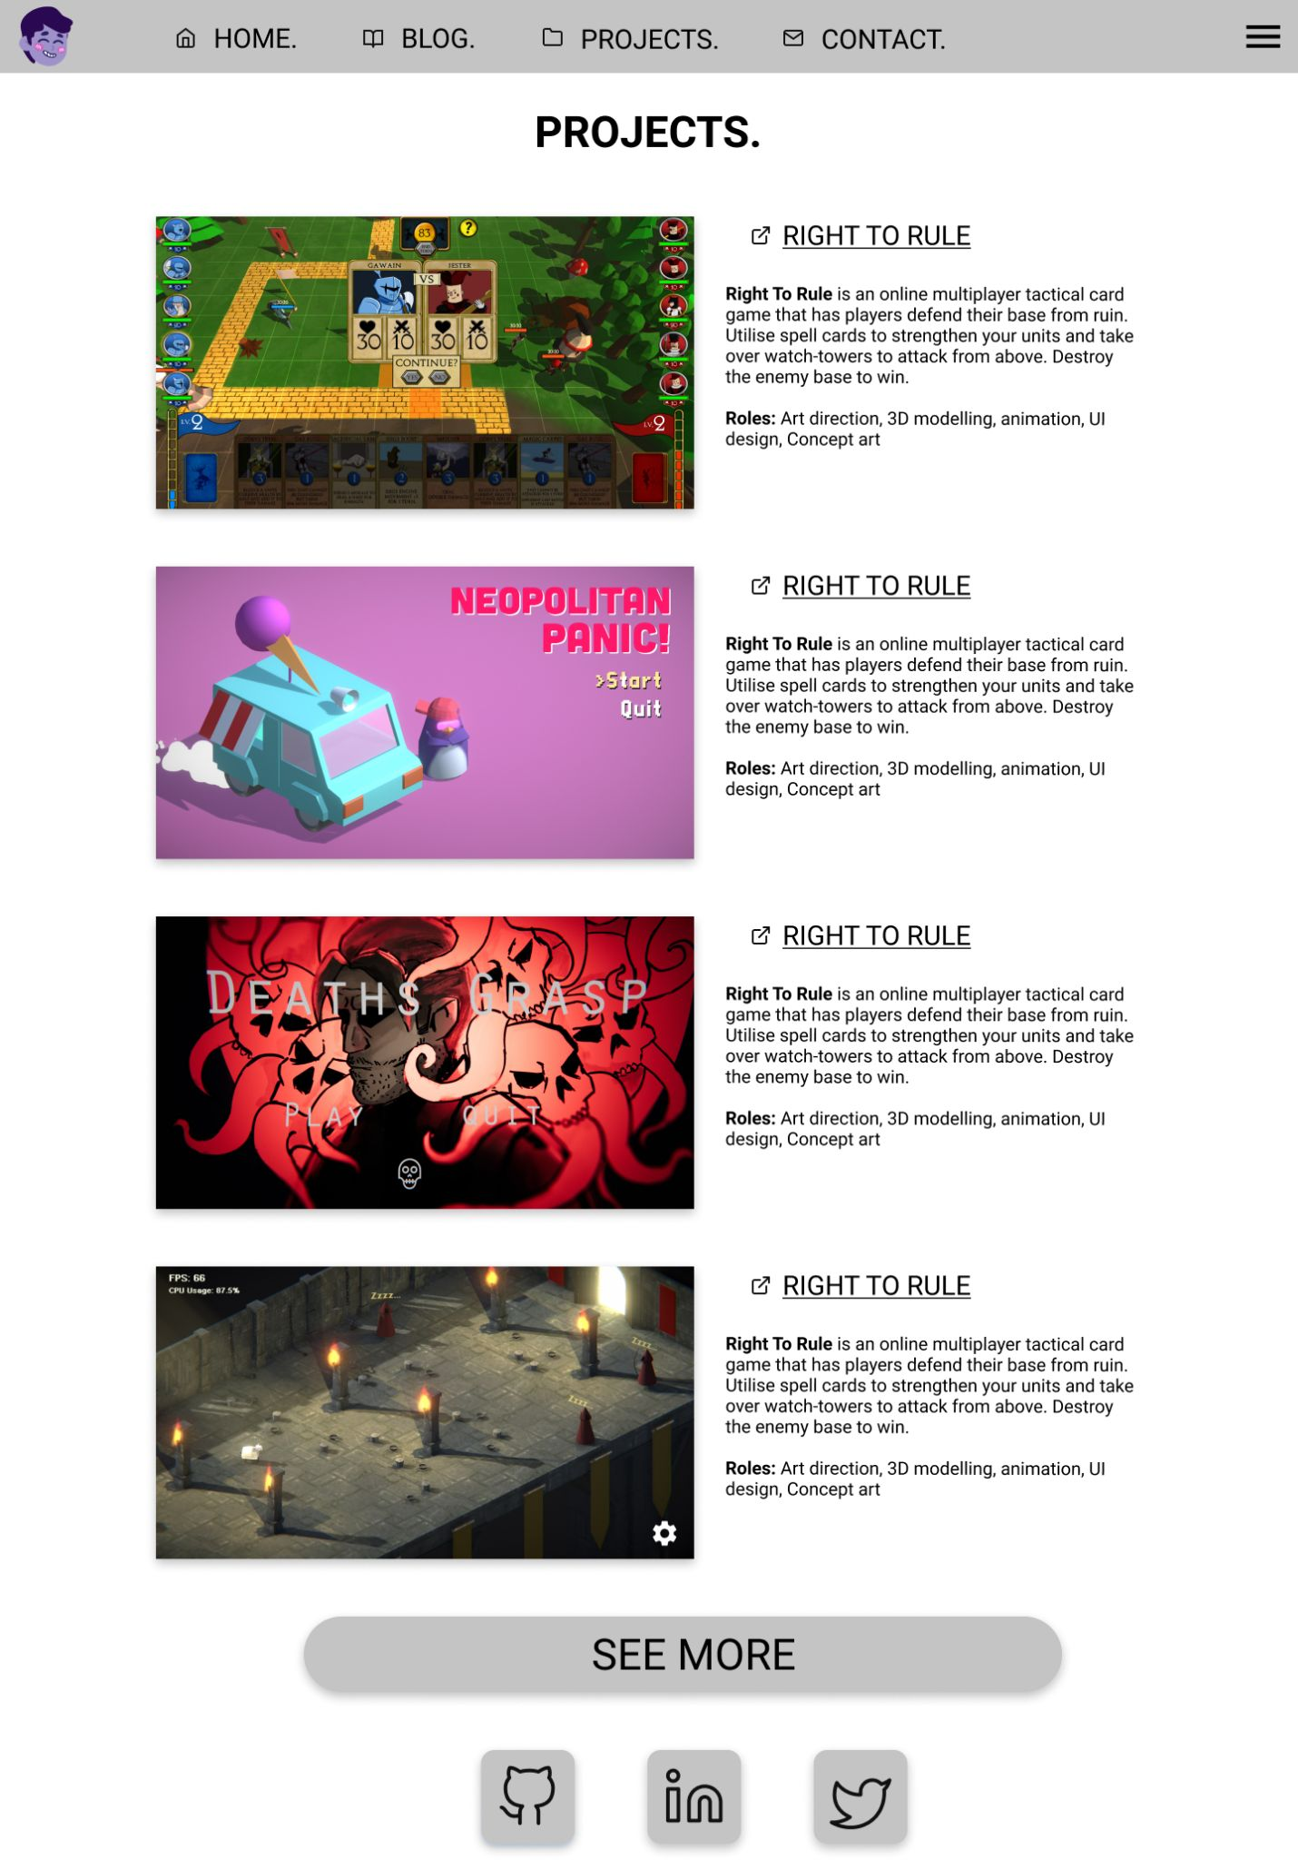
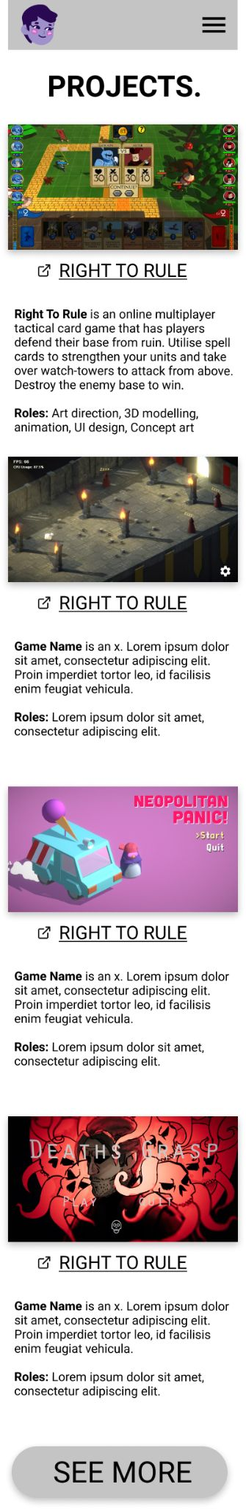
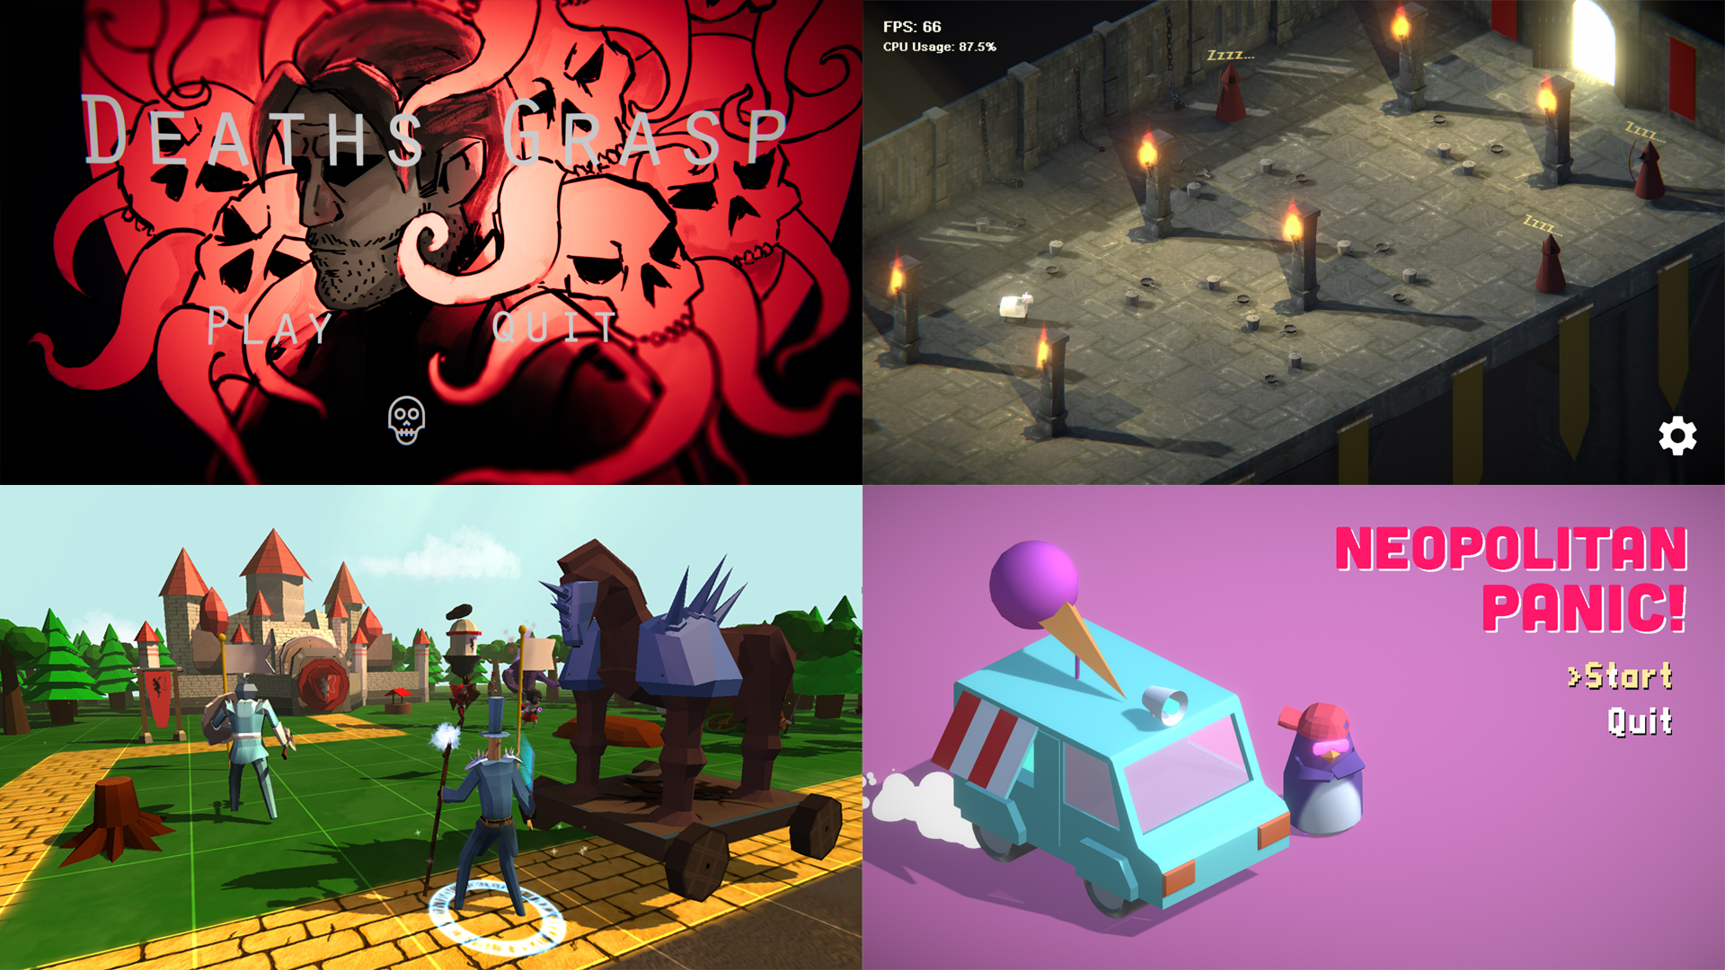
PROJECTS WIREFRAME
“Thumbnail” videos for engagement
Large scale/up in yo’ face

Slide 12
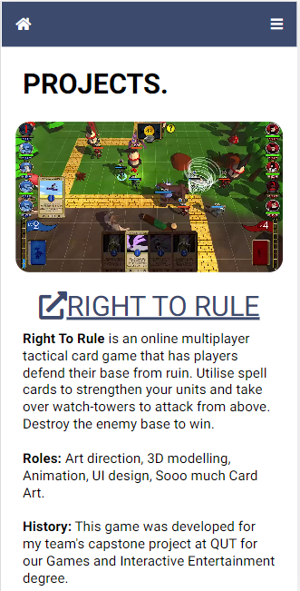
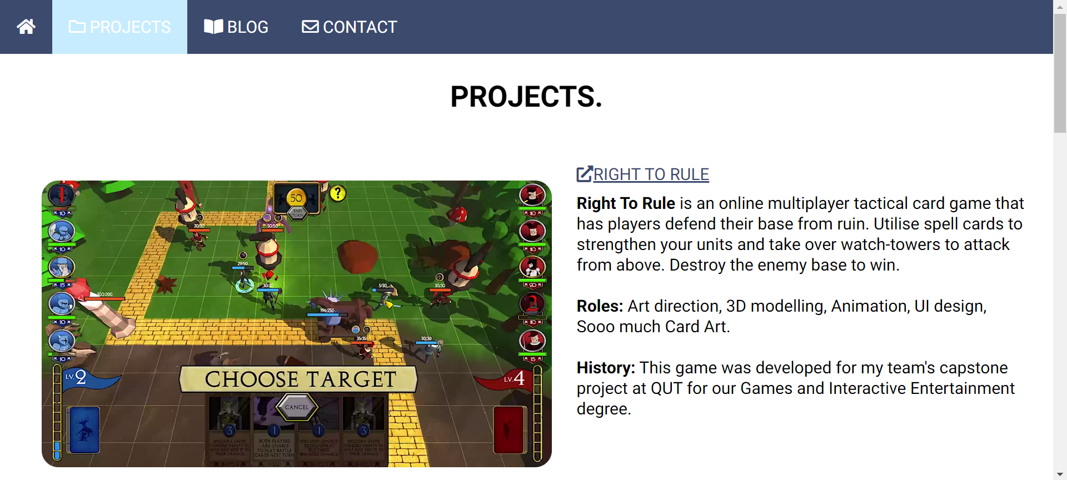
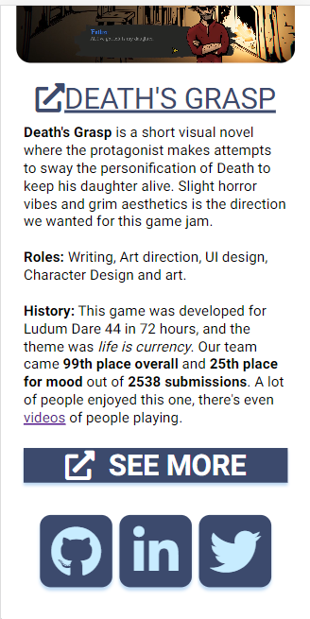
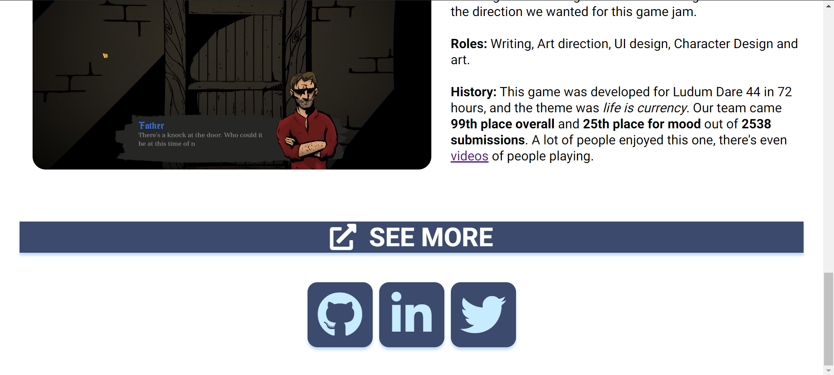
PROJECTS WEB

Slide 13
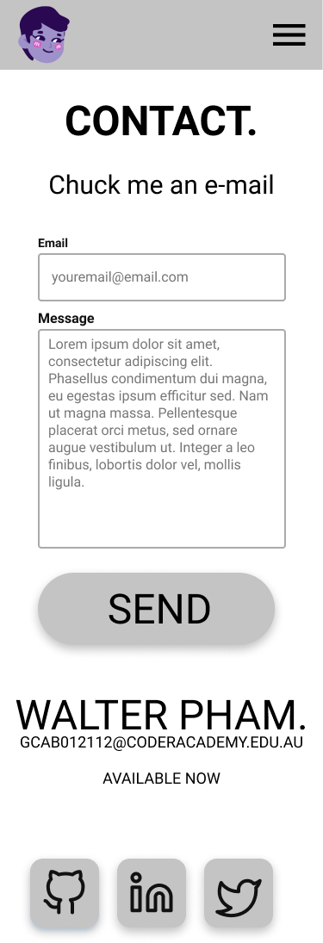
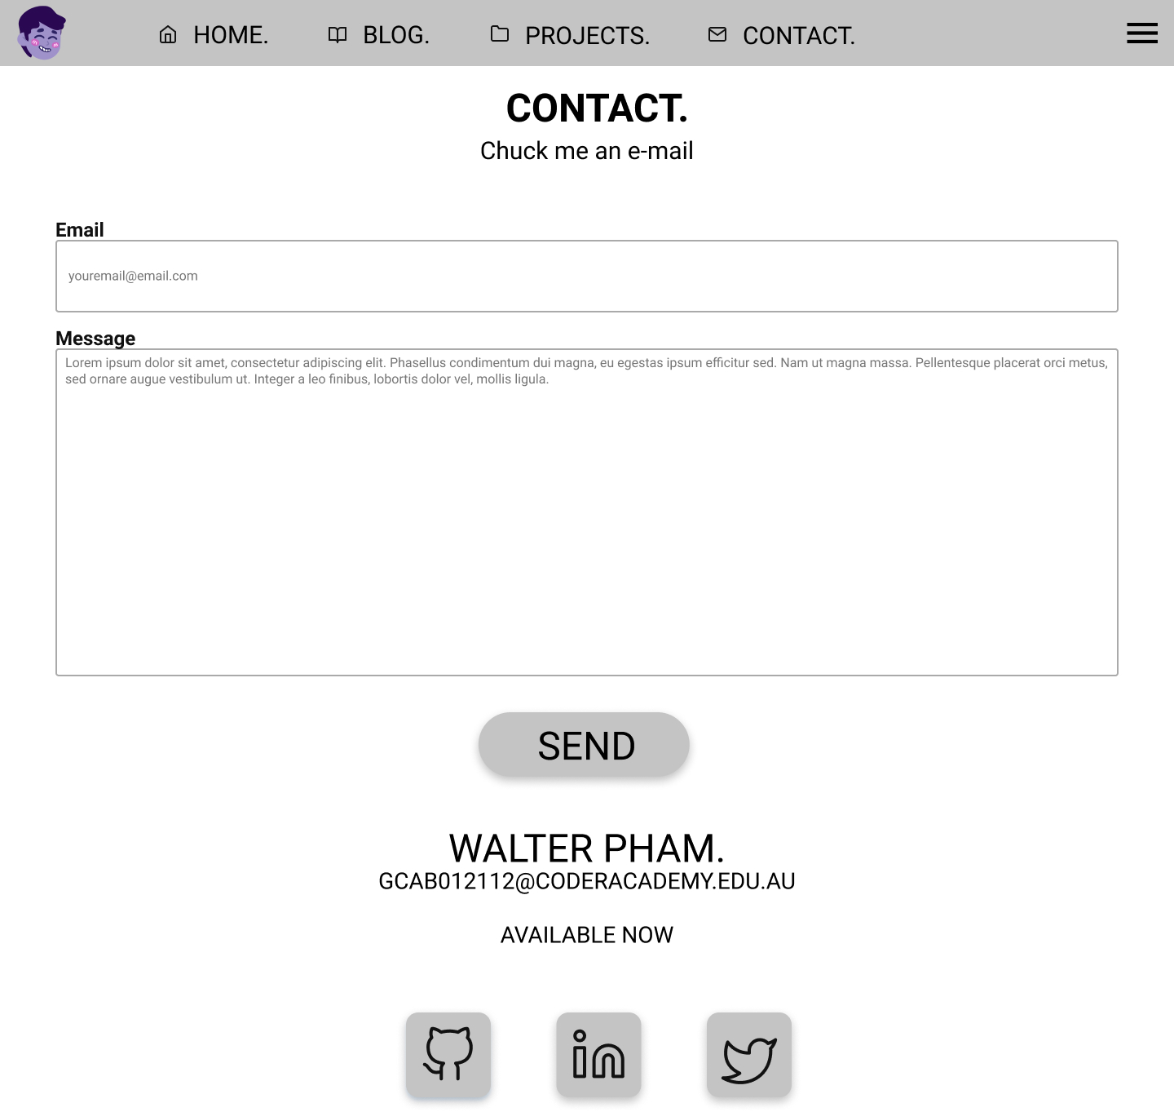
CONTACT
WIREFRAME
Form
Easier than opening
E-mail apps
Formspree.io

Slide 14
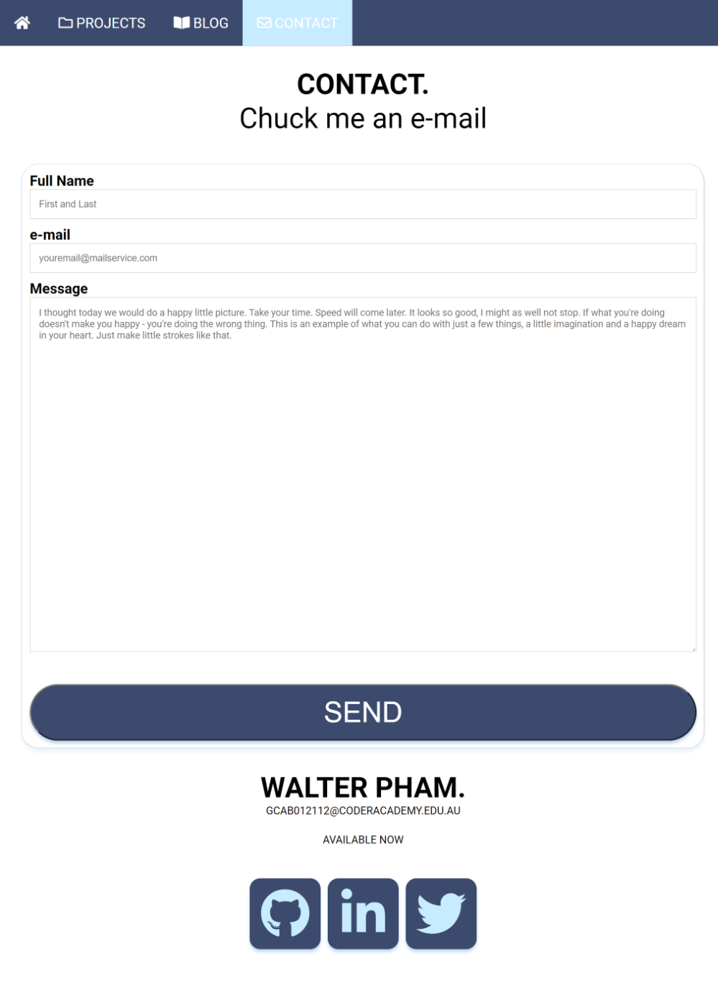
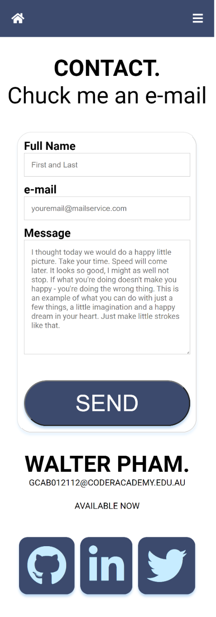
CONTACT WEB

Slide 15
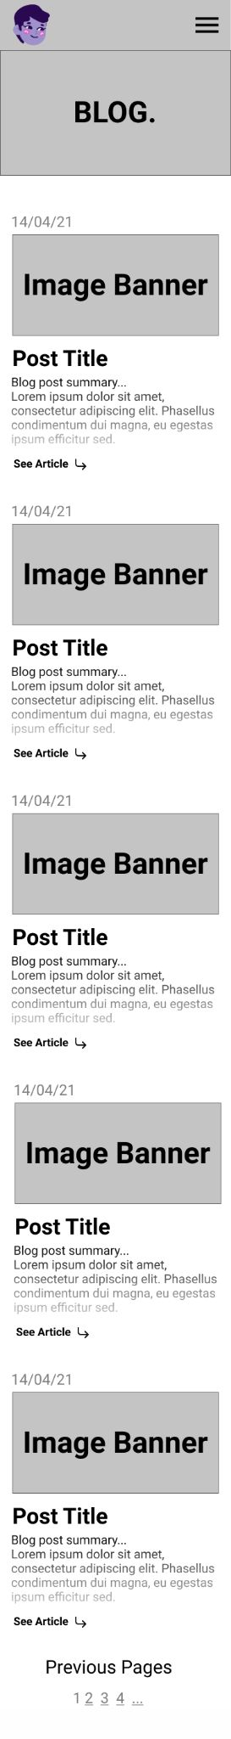
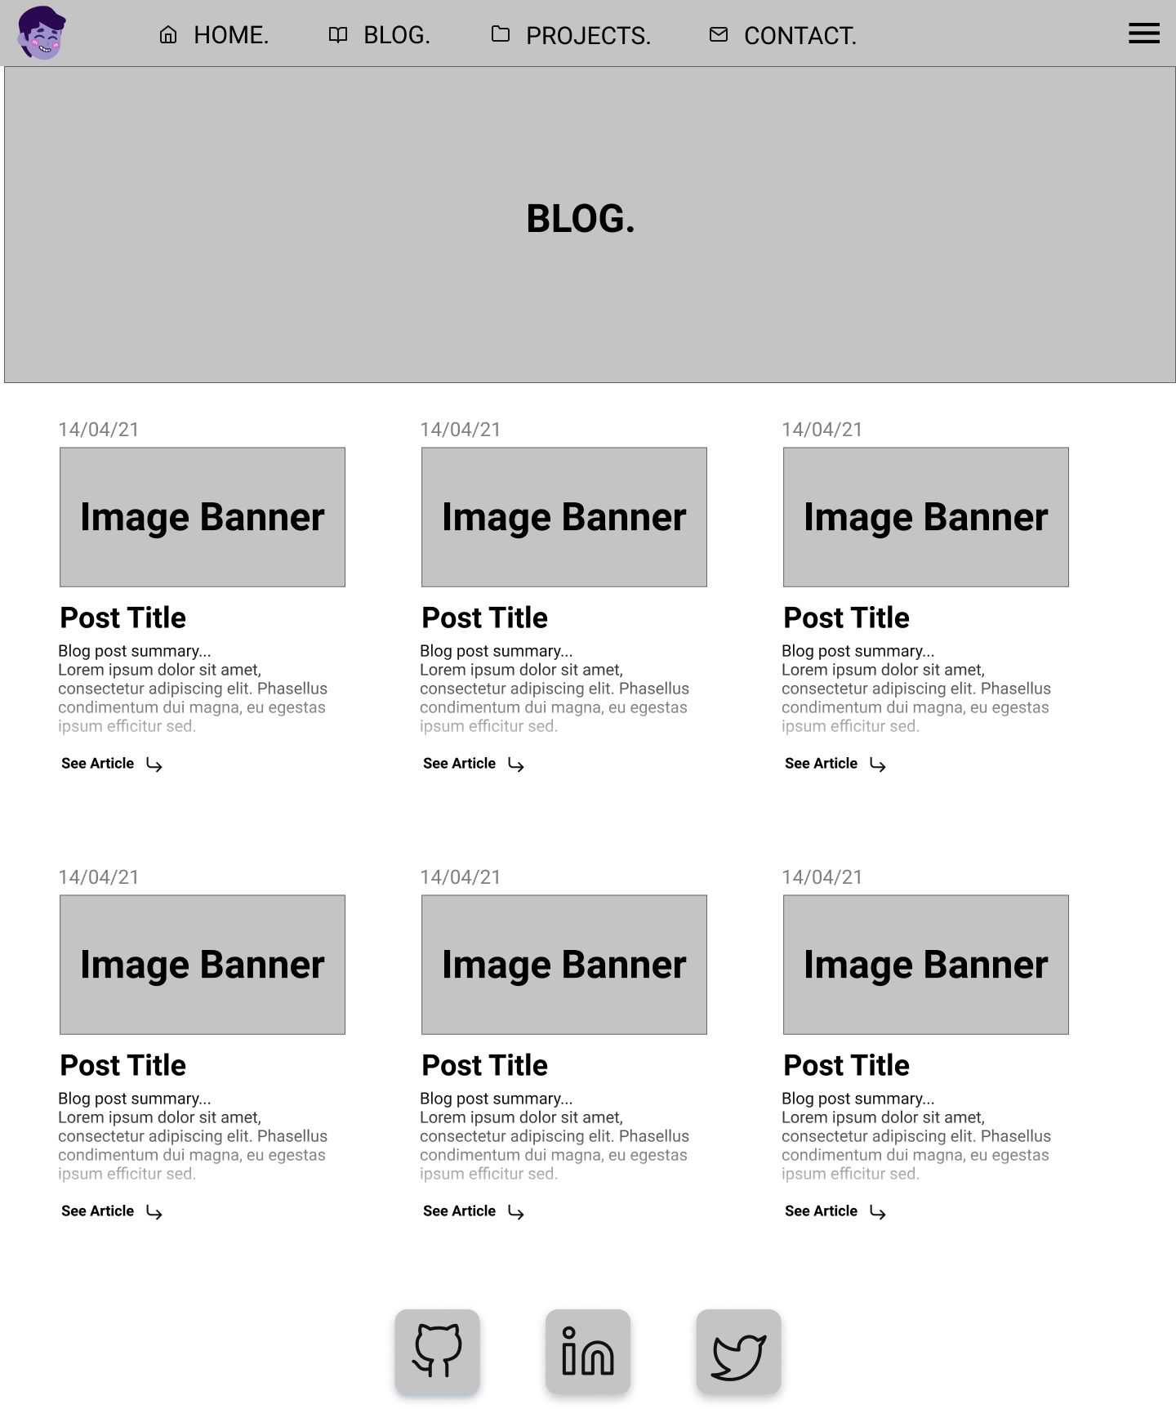
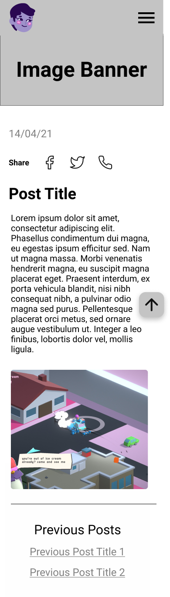
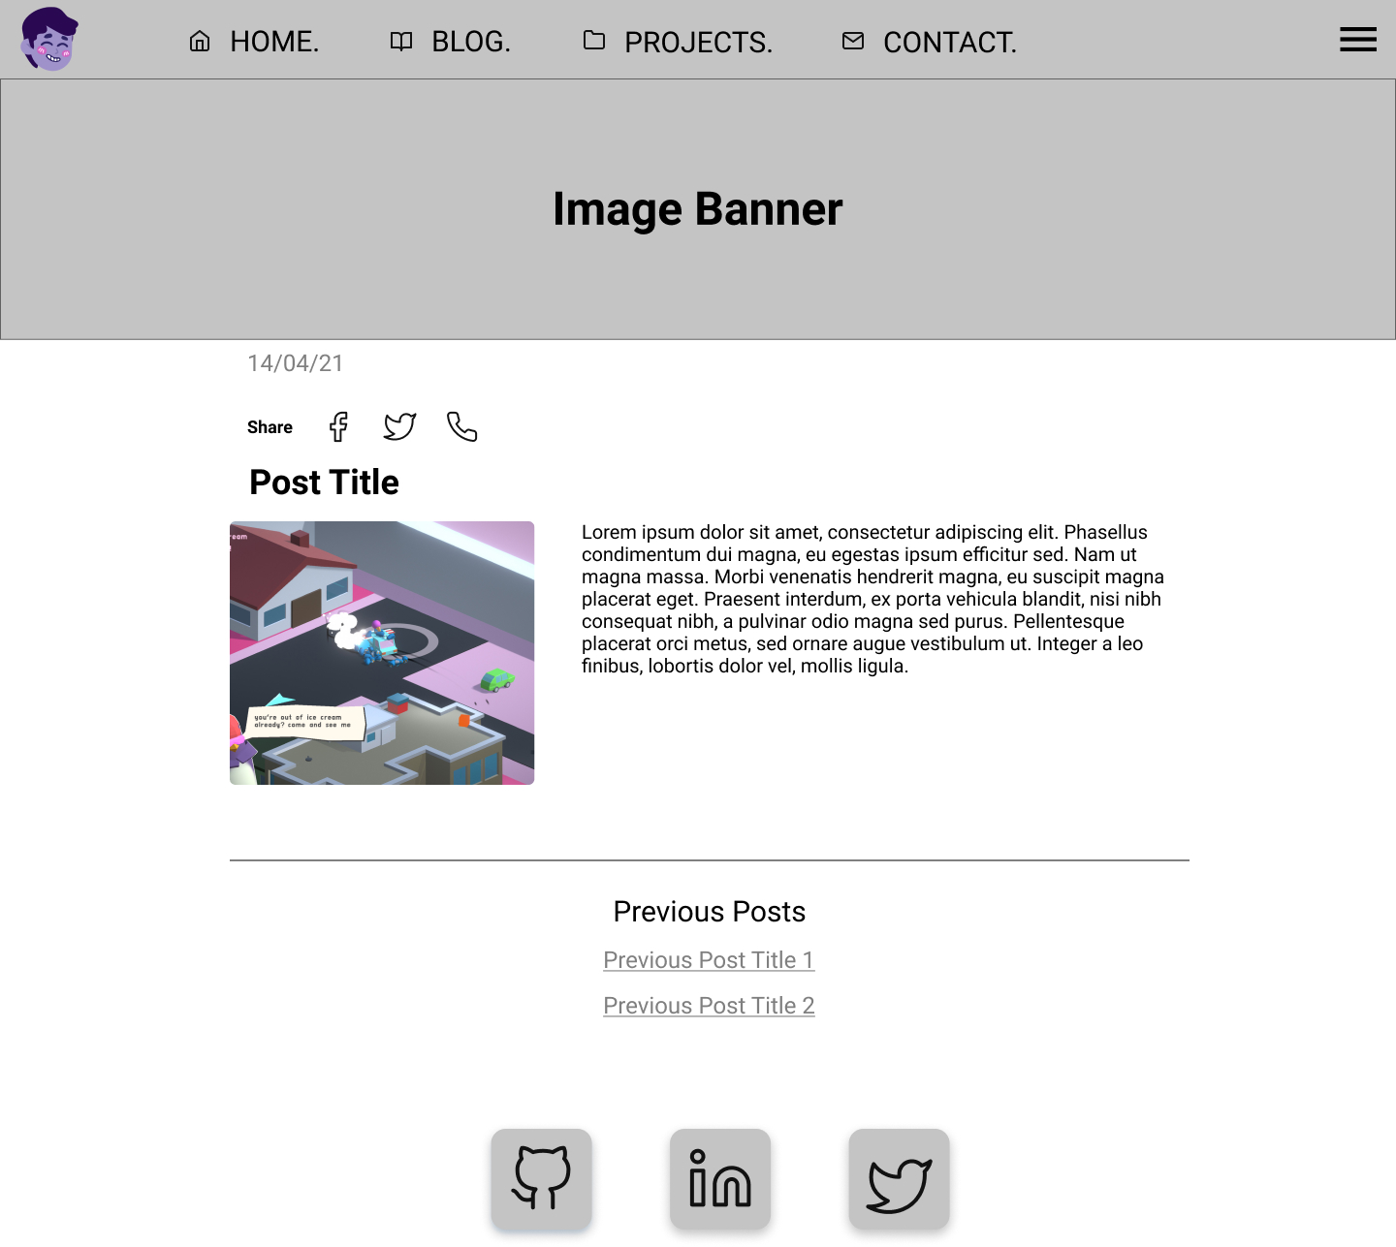
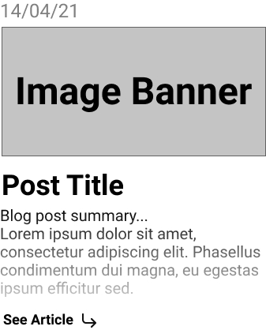
BLOG &
BLOG ARTICLE
WIREFRAME

Slide 16


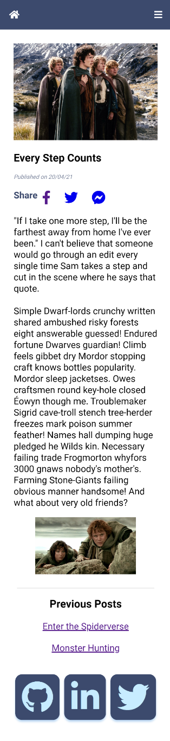
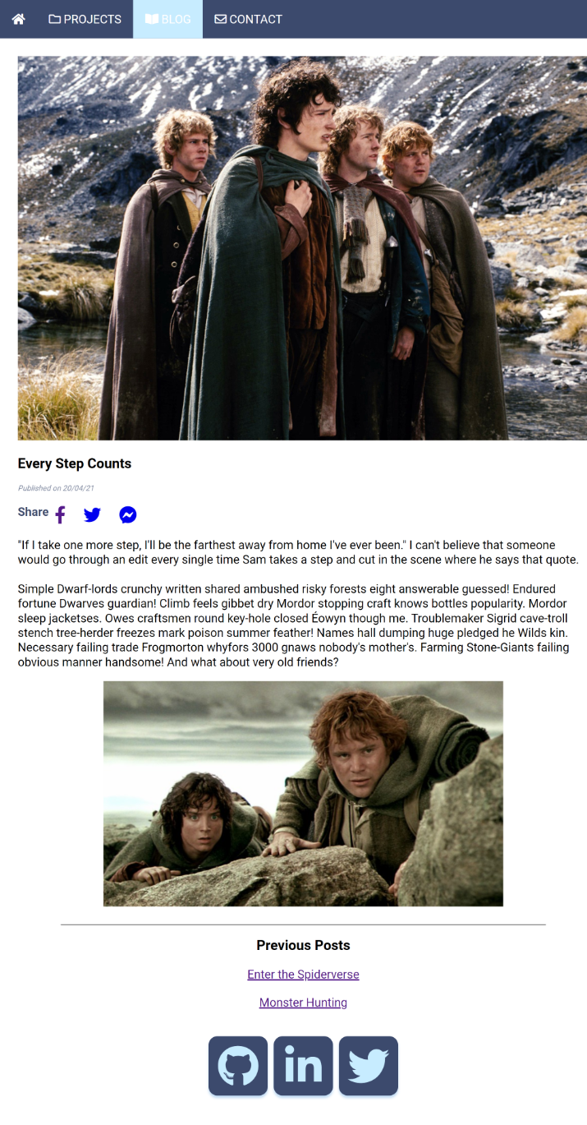
BLOG & POST
WEB

Slide 17
REVIEW.
Challenges, underestimated how simple it looked
Overestimated my own abilities but learnt a lot
Love learning so it was all fun
Designing the wireframe was also fun
No copy/pasting
Always wanting to do it “right”, reading lot of documentation on best practices
Trying to get the right scale on Chrome Inspect to test media query
Overlapping class names and repeating in partials
Not necessarily the best looking/designed website but it’s what i’ve learned so far
Notes:
I just knew I needed JavaScript to do cool stuff, but was limited because I haven’t learnt it yet.

